Slide 1
10,000 Cries for Justice 13th International Conference on Interdisciplinary Social Sciences University of Granada, Granada, Spain Don M. Tow President: NJ-ALPHA Co-Founder & VP: 10,000 Cries for Justice July 25, 2018

Slide 2
Outline
Historical Background
Seeking Justice: A New Initiative
Digital Archive Project
“10000 Cries for Justice” Website
New Educational Tool

Slide 3
Historical Background
During WWII, the Japanese military committed many atrocities in many countries in Asia
Comfort women (or Sex slaves)
Biological and chemical weapons of mass destruction, including vivisection of Chinese civilians and American POWs
Nanking Massacre
Slave labor
Many of the perpetuators were never prosecuted, including none of the leaders of Unit 731
When China and Japan normalized their relation on 9/29/1972, China, as a gesture of good will, renounced its demand for war preparations from Japan
Although there is extensive evidence and 70+ years have elapsed since WWII ended, the Japanese government still has not admitted and apologized for these atrocities, often claiming that these atrocities were fabricated

Slide 4
Vivisection of American POWs
Japanese Medical School Museum Exhibits Vivisection Display on American POWs: (The Japan Time News, 04-04-2015)
The Kyushu University in Fukuoka recently displayed an exhibit of vivisection (operation on live humans without anesthesia) on American POWs in their new medical history museum. These are documents in their possession for decades, but never publicly revealed. The vivisection victims were eight American airmen shot down in 1945 from an American B-29 bomber. They were captured as POWs, and then were vivisected by the Japanese doctors at this medical school. The doctors killed the American POWs by injecting diluted seawater into their veins, removing their lungs or livers and performing other horrific experiments on their bodies to test their limits.
To read more, click: http://www.japantimes.co.jp/news/2015/04/04/national/new-kyushu-museum-breaks-taboo-with-pow-vivisection-display#.VclAq_lcBuk

Slide 5
Non-Prosecution of Unit 731 Leaders
After WWII, the U.S. and Japan signed a secret agreement that none of the Unit 731 leaders will be prosecuted for war crimes in exchange for sharing their scientific knowledge and skills in developing biological weapons of mass destruction
But this is no longer a secret due to declassification and publication in many books and articles, e.g.,
Dr. Martin Furmanski, an American medical historian, wrote “In a disgraceful agreement with the Japanese biological weapons war criminals, the U.S. offered immunity from war crimes prosecution in exchange for the scientific data the Japanese had collected from murdering Chinese citizens, as well as citizens of other countries, both in their laboratories and in field applications. The official U.S. and Japanese policy became one of denying the existence of the Japanese biological weapons program.”
Sheldon Harris’s book: Factories Of Death: Japanese Biological Warfare, 1932-1945, and the American Cover-Up
Daniel Barenblatt’s book: A Plague upon Humanity: The Hidden History of Japan's Biological Warfare Program
Jeanne Guillemin’s book: Hidden Atrocities: Japanese Germ Warfare and American Obstruction of Justice at the Tokyo Trial

Slide 6
Seeking Justice: A New Initiative
After studying many legal documents and investigating many international legal cases regarding war reparations, Mr. Tong Zeng of Beijing, a young man with a masters degree in law, wrote a White Paper in 1990 stating that war reparation to a government is different from war reparation to the people
The 1972 Sino-Japanese Joint Communique only relieved Japan from paying war reparations to the Chinese government, but it doesn’t relieve Japan from paying war reparations to the Chinese people
Once that became known to the public, within a few years Mr. Tong Zeng received about 10,000 letters from Chinese victims describing their wartime atrocity experiences
These letters are known as “10,000 Cries for Justice”
They provide undeniable evidence of the atrocities Japan inflicted on the Chinese people

Slide 7
Digital Archive Project
Mr. Tong kept these letters in his office
After 20 years, when Japan still has not apologized, he thought about putting these letters in the public domain to inform the world
In early 2014, when David Chai and I heard about this, we contacted Mr. Tong asking him whether we can collaborate with him to develop a digital archive for these letters
He willingly accepted. After 1.5 years of hard work, in a press conference in Beijing in July 2015 we announced to the world the “10,000 Cries for Justice” website (www.10000cfj.org)
During the intermittent 20 years, many letters were borrowed by relatives and media people and never returned; so about half of the letters have been lost
4,000 Chinese letters were posted, about 12% of the letters were translated into English and also posted. More English translations will follow
Notes:
The idea of taking off from carriers originated from Captain Francis S. Low, a staff member of Admiral Ernest J. King, Chief of Naval Operations
Doolittle: MS and Ph.D. from MIT
Already famous as a record-setting long distance speed pilot
Bomber’s armament was reduced. Removed 230-pound liaison radio (since radio silence was required during mission). Additional fuel tanks were added.
Hopefully with enough fuel to land on China coast.
Actually wanted to land on USSR’s Vladivostok, which was several hundred miles closer and less chance of running into Japanese troops on the ground. But refused by USSR because of neutrality pact between USSR and Japan.
People didn’t know what they were volunteering for except that it was an extremely dangerous mission.

Slide 8
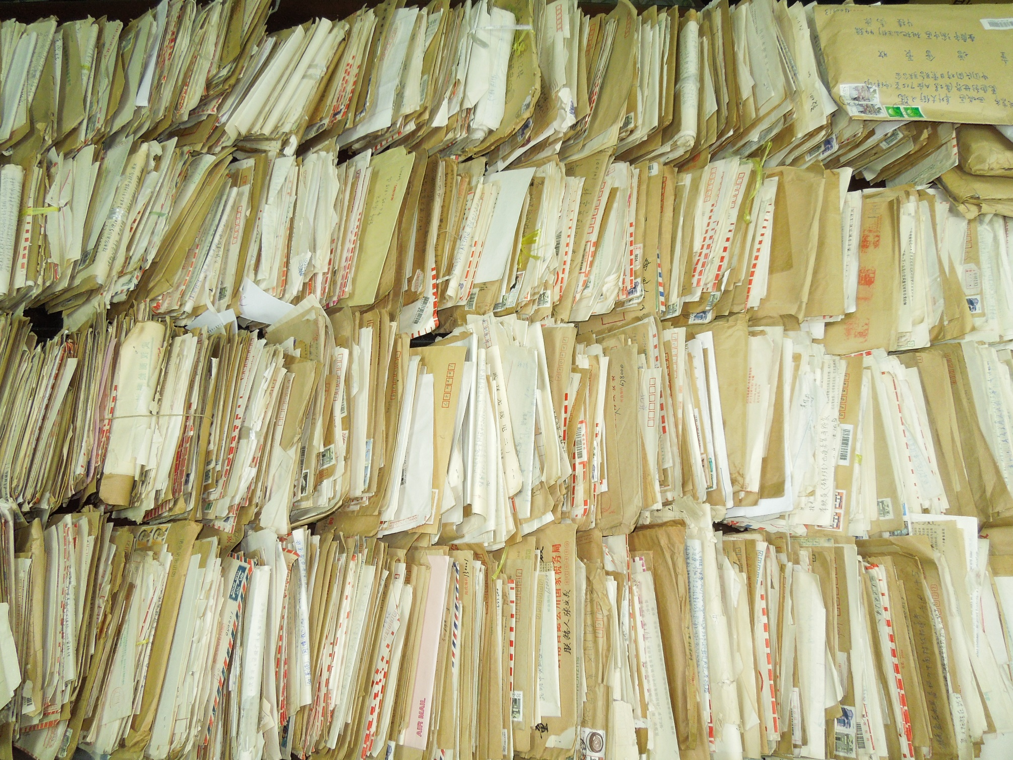

Slide 9
“10,000 Cries for Justice” Website
Contents of bi-lingual website
Scanned image of letter envelope
Scanned image of each page of Chinese letter
Digital file of transcribed Chinese letter
Digital file of the English translation of Chinese letter
Each letter is assigned an index file with:
A unique ID
Atrocity category: Air Bombing, Biological/Chemical Warfare, Murders, Nanking Massacre, Other Massacres, Sex Slaves, Slave Laborer, Others
Date of event
Name(s) of victim(s)
Location of event
Date of letter
Name of author
Address of author
Website provides search algorithm based on index file
Notes:
The idea of taking off from carriers originated from Captain Francis S. Low, a staff member of Admiral Ernest J. King, Chief of Naval Operations
Doolittle: MS and Ph.D. from MIT
Already famous as a record-setting long distance speed pilot
Bomber’s armament was reduced. Removed 230-pound liaison radio (since radio silence was required during mission). Additional fuel tanks were added.
Hopefully with enough fuel to land on China coast.
Actually wanted to land on USSR’s Vladivostok, which was several hundred miles closer and less chance of running into Japanese troops on the ground. But refused by USSR because of neutrality pact between USSR and Japan.
People didn’t know what they were volunteering for except that it was an extremely dangerous mission.

Slide 10
Sample Letters
Air Bombing: ”More than 8,000 people died from being buried alive, burning to death, freezing, boiling with hot water, cramming pepper water, poisoning, attacking by hounds, starving, body splitting by horses (all kinds), hanging, skinning, mutilation, (gang) raping, live targets of shooting and flesh carving. … After the Japanese army retreated in May 1945, 25 shoulder pole loads of human bones were excavated, more than 2,700 skeletons were discovered across the area. … 18 women were raped (gang raped) before death, over 500 women were raped by brutal force; these women were stripped and raped in broad daylight, and “teased” before being raped, some even died from splitting the body with knife.” - Tang Qiangshen, Wuyi County, Zhejiang, 12/15/1992
Biological/Chemical Warfare: “Furthermore, in 1941 when the Japanese Army invaded Western Yunnan, after Baoshan was conquered, large crowds of residents living in Baoshan and other places in Western Yunnan swarmed to Kunming to avoid slaughter by the Japanese Army. Immediately afterwards cholera broke out in Kunming. At first people thought it was epidemic plague, but soon it spread to the whole city. Those contracted cholera first would have symptoms of vomiting and diarrhea, and soon they died in less than one day. On the streets one could see dead people each day. All the coffins were sold out.” - Tang Qingyu, Kunming, Yunnan, 11/20/1992
Sex Slaves: “At over 11 p.m. that night, someone opened the door and took me to another room. After I entered the room, I saw a black-face officer and realized something bad was going to happen, so I cried out loud, which made the officer angry. He kicked me with leather shoes and dragged me on the bed. Then, he gagged me, stripped off all my clothes and raped me. I just turned 14 and was ruined by them. At dawn, I was taken back to the room where I was first kept. After that, every day from dawn to night, I would be raped by the Japanese for over 20 times.” - Hou Qiaolian, Yangquan City, Shanxi, November 1992
Notes:
The Japanese sentinel boat radioed an attack warning to Japan
First bomber, piloted by Doolittle, took off from carrier at 08:20, and all 16 bombers took off within an hour
Since they took off at 600 miles, and not 400 miles from Japan, they might not have enough fuel to reach China
Because they departed in the morning, instead of evening, it would be nighttime when the bombers reach the China coast, making it more difficult to land
To reduce detection, they flew just above water line on way to Japan, and just above tree line after dropping their bombs
All but one successfully dropped their bombs on 10 military and industrial targets in Tokyo, two in Yokohama, and one each in Yokosuka, Nagoya, Kobe and Osaka.

Slide 11
New Educational Tool
Digital archive preserved letters for perpetuity
Available to the world 7x24
Bilingual
Support simultaneous access by multiple users
Reporters can write articles
Students can write reports or term papers
Museums can provide a work station to visitors to explore and learn from this website
Plays, documentaries, and books can be written based on this material
Can house additional first-hand recollections from more atrocity victims or their relatives
With enough funding, will translate into Japanese also
Notes:
The Japanese sentinel boat radioed an attack warning to Japan
First bomber, piloted by Doolittle, took off from carrier at 08:20, and all 16 bombers took off within an hour
Since they took off at 600 miles, and not 400 miles from Japan, they might not have enough fuel to reach China
Because they departed in the morning, instead of evening, it would be nighttime when the bombers reach the China coast, making it more difficult to land
To reduce detection, they flew just above water line on way to Japan, and just above tree line after dropping their bombs
All but one successfully dropped their bombs on 10 military and industrial targets in Tokyo, two in Yokohama, and one each in Yokosuka, Nagoya, Kobe and Osaka.

